Slide 1

Case study: How Does a Bike-share Company Navigate Speedy Success?

Slide 2
Business Goal
• Understand usage patterns How do annual members and casual riders use Cyclistic bikes differently?
• Identify conversion motivators What would make casual riders purchase annual memberships?
• Leverage digital media How can Cyclistic use digital platforms to influence casual riders to become annual members?

Slide 3
Scope of work (SOW)
Data analyst team wants to understand how casual riders and annual members use Cyclistic bikes differently.
From these insights, team will design a new marketing strategy to convert casual riders into annual members.
Executive approval is necessary for recommending new strategies, so compelling data insights and clear visualizations are essential.

Slide 4
Comprehensive Analysis and Visual Insights Project Summary
1. Business Task: A clear statement defining the business problem and objectives.
2. Data Sources: A detailed description of all data sources used in the analysis.
3. Data Cleaning and Preparation: Documentation of any data cleaning, transformation, or manipulation performed.
4. Analysis Summary: A concise summary of key insights derived from the data.
5. Visualizations and Findings: Supporting charts, graphs, and key takeaways from the analysis.
6. Recommendations: My top three data-driven recommendations based on the findings.

Slide 5
Main Findings Between Both User Groups Annual Members
• Higher usage during weekdays (Monday to Friday) Annual member primarily rely on the service for daily commuting.
• Familiarity with the service Regular use makes the annual members well-acquainted with nearby docking stations, which improves ease of use.
• Cost-effectiveness The subscription model is budget-friendly for regular users.
• Lower usage on weekends and public holidays Annual members prioritize rest or other leisure activities on weekends.

Slide 6
Main Findings Between Both User Groups Casual Riders
• Higher usage on weekends and public holidays Casual riders are more likely to use the bike-share service for leisure or recreational purposes.
• Curiosity-driven usage Many casual riders try the service out of curiosity or for occasional leisure trips.
• Increased bike availability on weekend Higher bike availability on weekend may encourage more casual usage.
• Significant usage drop on weekdays Bookings decline sharply from Monday to Friday, potentially due to: * difficulty in booking or accessing bikes,
* lack of trust in the service,
* or lack of familiarity with the service.

Slide 7
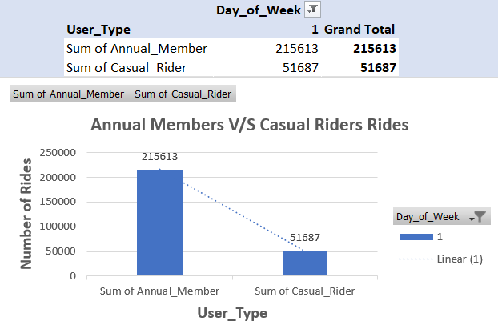
1st day of week Ride Usage Comparison Annual Members vs. Casual Riders

Slide 8
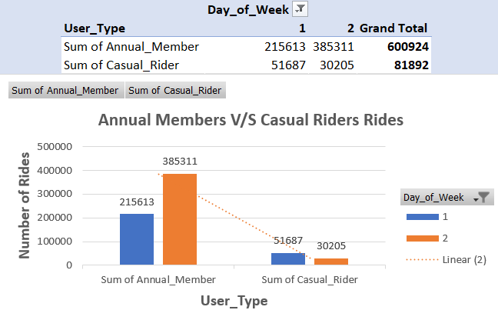
1st and 2nd day of week Ride Usage Comparison Annual Members vs. Casual Riders

Slide 9
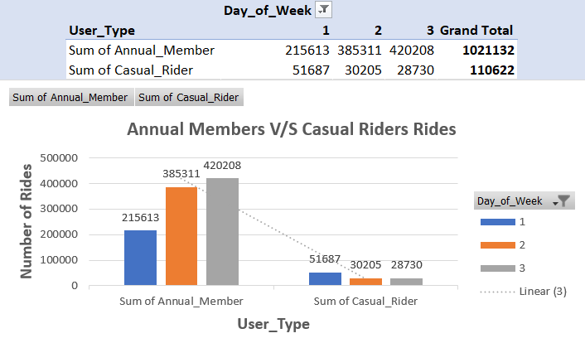
1st to 3rd day of week Ride Usage Comparison Annual Members vs. Casual Riders

Slide 10
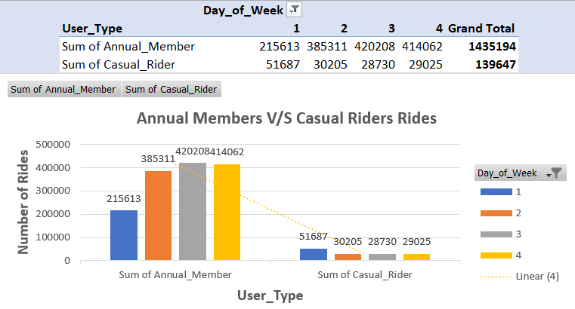
1st to 4th day of week Ride Usage Comparison Annual Members vs. Casual Riders

Slide 11
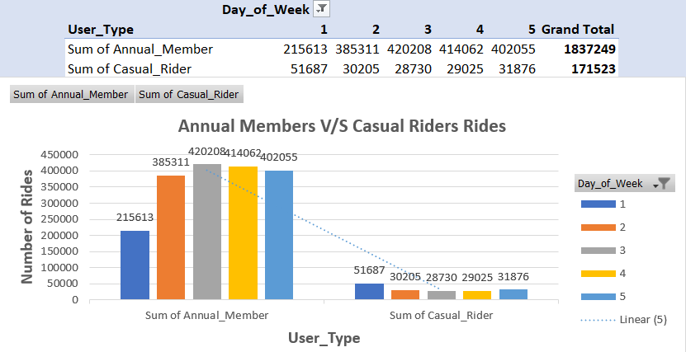
1st to 5th day of week Ride Usage Comparison Annual Members vs. Casual Riders

Slide 12
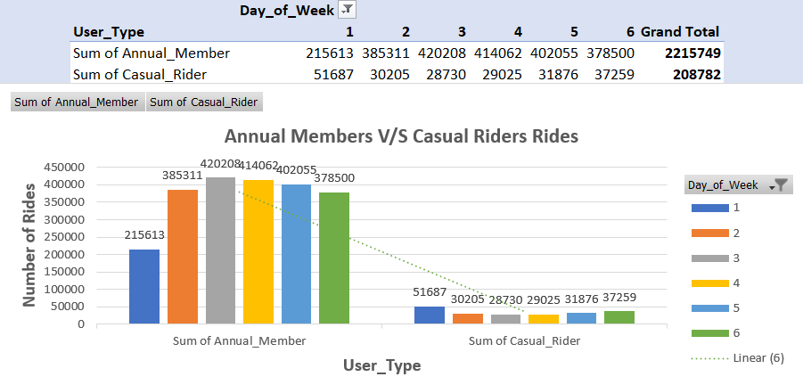
1st to 6th day of week Ride Usage Comparison Annual Members vs. Casual Riders

Slide 13
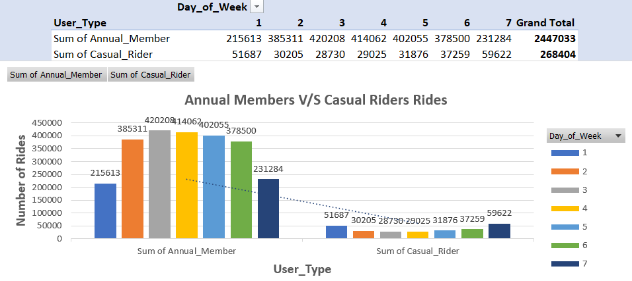
1st to 7th day of week Ride Usage Comparison Annual Members vs. Casual Riders

Slide 14
Recommendation#1 Based on Analysis
Enhance First-Time User Experience
Simplify the booking process
Introduce a step-by-step guide within the app to help new users navigate the service easily.
Provide user-friendly tutorials
Offer easy-to-follow tutorials at docking stations to assist users in getting started.
Launch a "First Ride Free" campaign
Allow new users to try the service risk-free, to build trust and encourage adoption.

Slide 15
Recommendations#2 Based on Analysis
2. Implement Targeted Promotions and Discounts
Weekend-to-weekday transition discounts Offer incentives such as "Get 50% off your first month as an annual member“ to encourage casual riders to transition to annual membership.
Family or group plans Introduce discount plans for families or groups to promote frequent use.
Personalized membership offers Send tailored membership offers via email or app notifications after a user’s first few rides to encourage long-term commitment.

Slide 16
Recommendations#3 Based on Analysis
3. Improve User Retention and Engagement
Gather continuous feedback Regularly collect user feedback to identify pain points and areas for improvement.
Implement loyalty programs Introduce rewards or incentives for frequent users to encourage ongoing engagement.
Keep users informed Regularly update users about new features, promotions, and events through the app and email notifications.

Slide 17

“With this all you can make your consumer your regular customers and increase the sale and revenue of your products”

